Slide 1
Employee Attrition Analysis
TEAM MEMBERS:
G.PRANAY
K.SATHWIK

Slide 2
Overview
Dataset Link: https://www.kaggle.com/datasets/pavansubhasht/ibm-hr-analytics-attrition-dataset/

Slide 3
Analysis

Slide 4
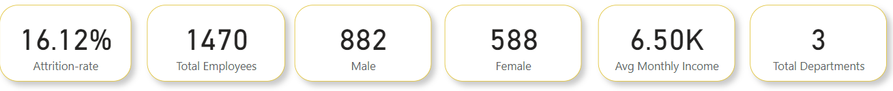
Analysis:
The overall attrition rate in the company is 16%, indicating a significant turnover of employees.The store generated 1 million in revenue.
Total Emplyees are 1470 in 882 are Males and 588 are Females.
The average monthly income is 6.50K.

Slide 5
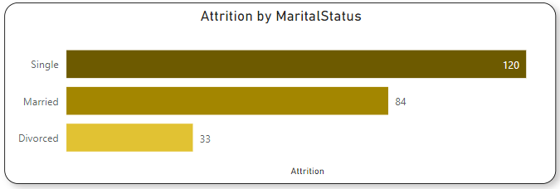
Attrition By Marital Status:
Marital status significantly affects attrition rates, with married employees being more likely to stay with the company than singles.

Slide 6
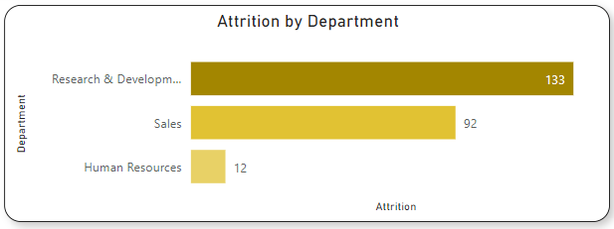
Attrition By Department:
Employees in the Research and development departments have a notably high attrition rate, indicating a need for targeted retention strategies in these areas.

Slide 7
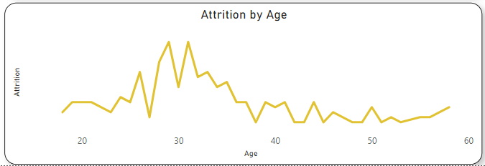
Attrition By Age:
The average age of employees is 37, indicating that the younger generation shows a higher attrition rate, which might be due to career exploration or other factors.

Slide 8
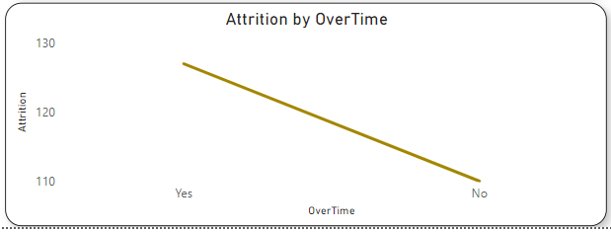
Attrition By Overtime:
Employees who work more overtime are more likely to depart from the company, suggesting that excessive work hours may contribute to attrition.

Slide 9
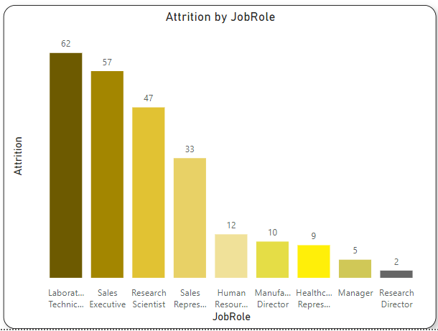
Attrition By Job Role:
The sales executive job role has the highest rate of job satisfaction and the highest income, even though it has the highest attrition after the laboratory technician job role.

Slide 10
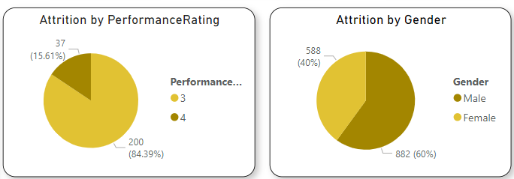
Attrition By Performance and Gender:
Males are more likely to depart from the company compared to females, suggesting a potential gender-based attrition pattern.
Employees with lower monthly incomes and high-performance rates are showing higher attrition rates, potentially indicating a need to revisit compensation structures and career growth opportunities.

Slide 11
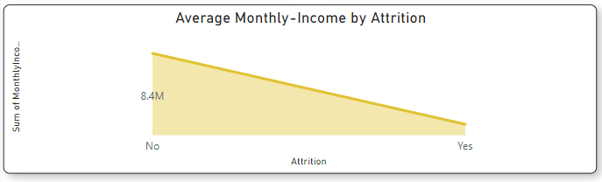
Avg Monthly income And Attrition:
Those who have less monthly income and high performing rates are showing more attrition rates

Slide 12
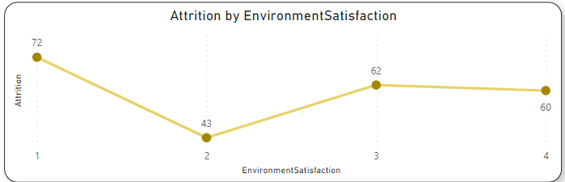
Attrition By Environment Satisfaction:
Employees who report lower satisfaction with the company's work environment are more likely to leave, underscoring the importance of fostering a positive workplace culture.

Slide 13
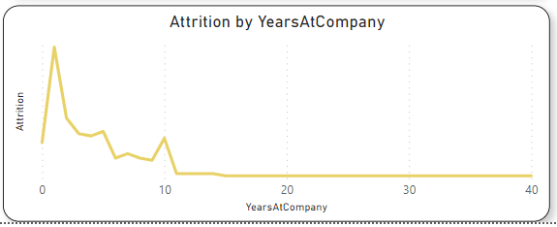
Attrition By Years At Company:
Employees with fewer years of experience with the company are more likely to depart, indicating the need for better strategies to retain newer hires

Slide 14
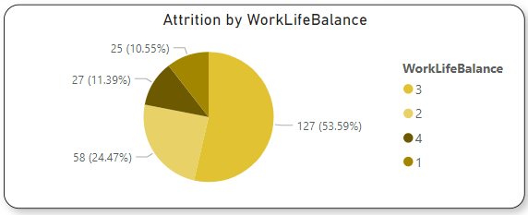
Attrition By Work Life Balance:
Employees who do not have a healthy work-life balance are more likely to leave, emphasizing the importance of promoting work-life equilibrium.

Slide 15
Strategies For Employee Retention:
Gender-Inclusive Policies: Implement gender-inclusive policies and programs to address the higher attrition rate among males, promoting equal opportunities and support.
Marital Support: Develop initiatives to support single employees and provide benefits that cater to their needs, ensuring a balanced work-life experience.
Age-Specific Programs: Tailor retention strategies for younger employees, including career development opportunities and mentorship programs to engage and retain them.
Departmental Interventions: Investigate the reasons behind high attrition in the sales and development departments, and address issues related to workload, recognition, and career progression.
Overtime Management: Implement policies and systems to manage and reduce excessive overtime, ensuring employees can maintain a healthy work-life balance.

Slide 16
Strategies For Employee Retention:
Compensation and Career Growth: Review compensation structures and provide a clear path for career growth to retain high-performing employees with lower incomes.
Improve Work Environment: Focus on improving the work environment and culture to enhance job satisfaction and overall employee well-being.
New Hire Retention: Develop onboarding programs and mentorship initiatives to engage and retain employees with less tenure.
Work-Life Balance Support: Promote work-life balance through flexible scheduling, remote work options, and wellness programs to reduce attrition among employees struggling with work-life balance.

